Slide 1

CYCLIST BIKE SHARE ANALYSIS
By K G GOKUL

Slide 2
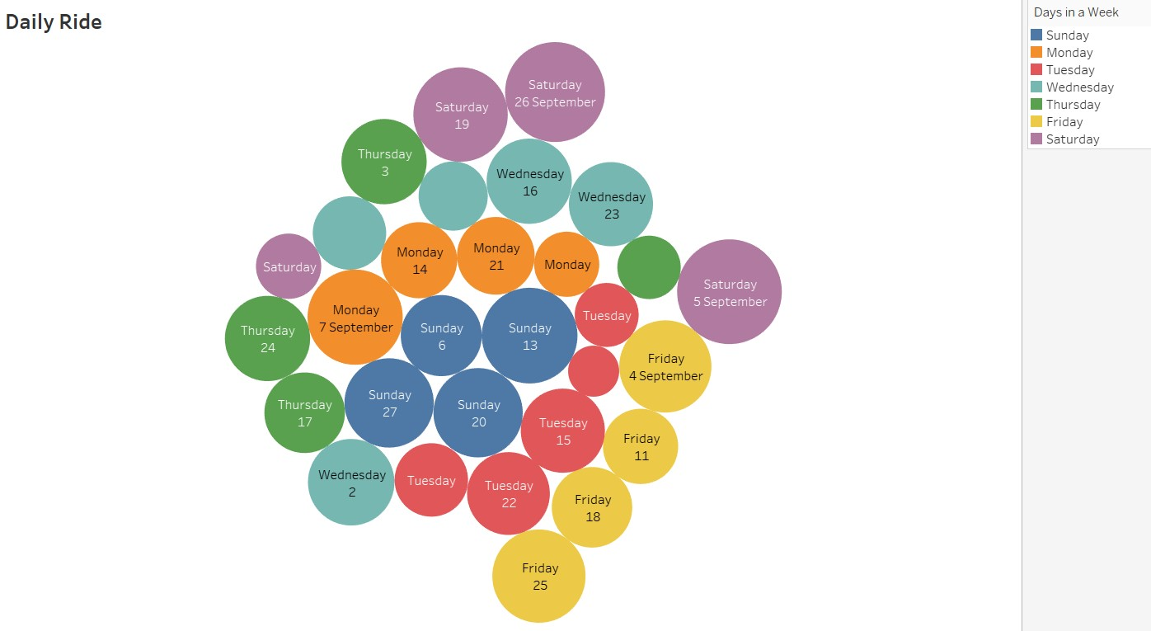
Daily Rides BY Days
This bubbles visualization shows the daily rides by days.
The visualization shows the highest daily rides done on Saturdays.
Thursday is the least daily rides reported.

Slide 3
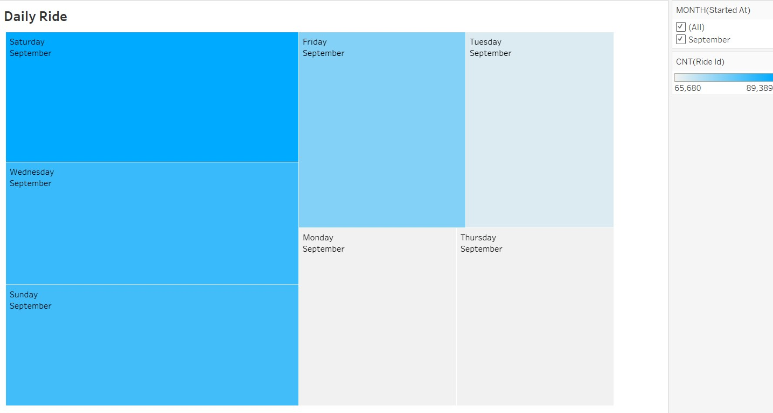
Daily Rides BY MONTHS
This Treemaps visualization shows the daily rides by months.
As the dataset consists of September Month 2020, this visualization shows the overall rides done from Monday to Sunday in the month.

Slide 4
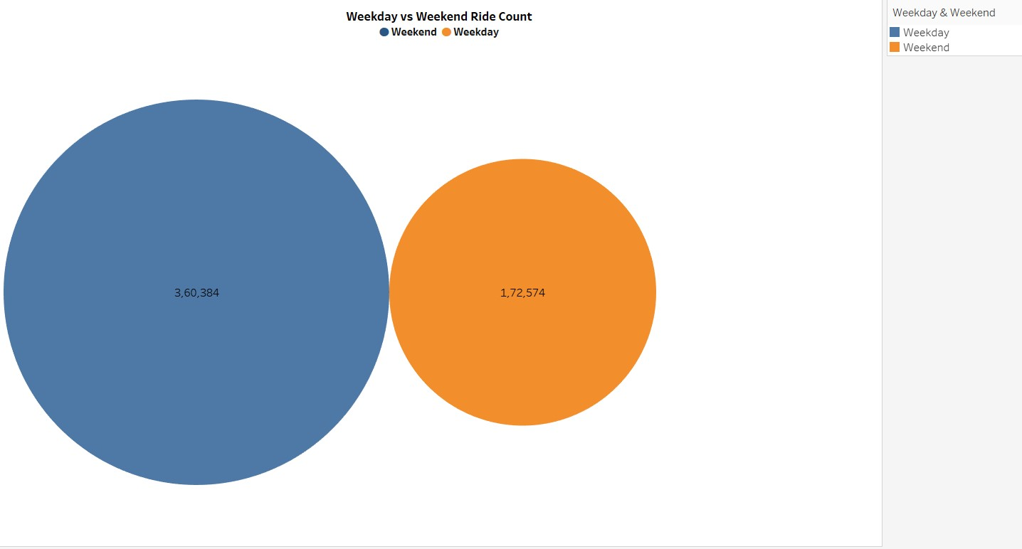
Weekend-Weekday Ride Count
This Pie Chart visualization shows comparison of Weekends & Weekdays ride count
Overall the visualization says, weekends has the higher number of counts rather than the counts of weekdays.

Slide 5
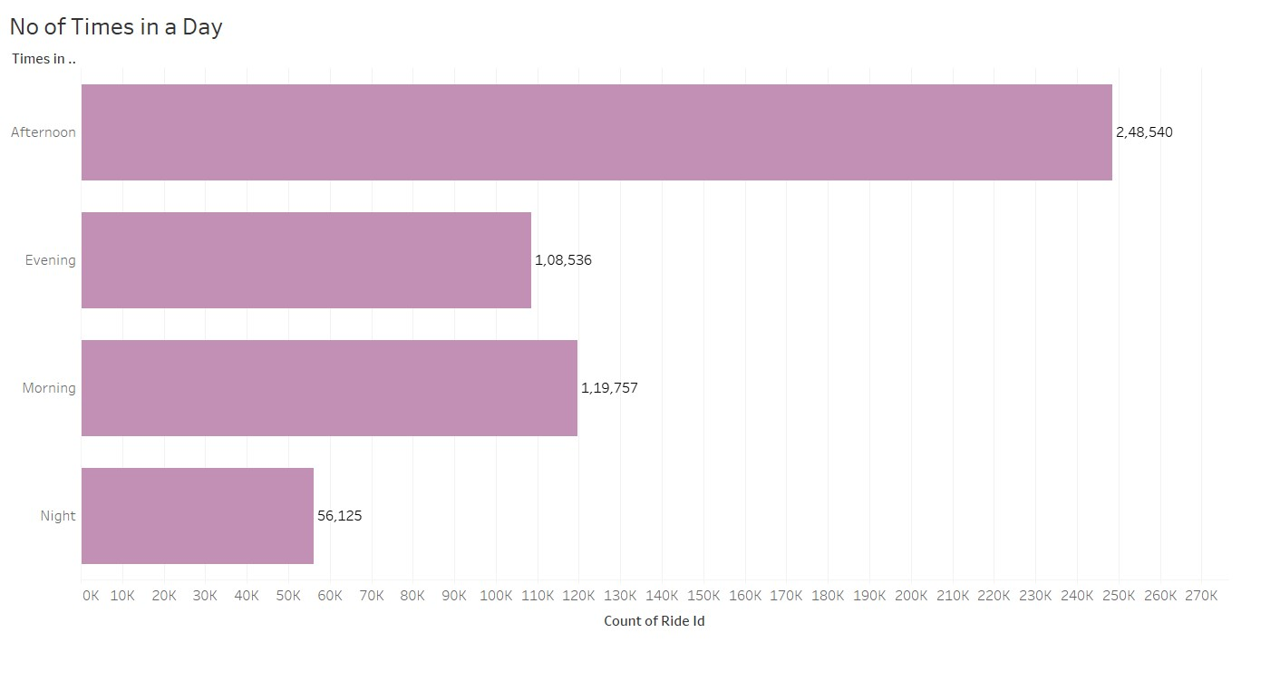
No of Times in a Day
This Horizontal bars visualization shows the number of times ride done in a day.
People loves to ride more at afternoon and shows less interest in the night.
However, morning also people shows some interest to ride.

Slide 6
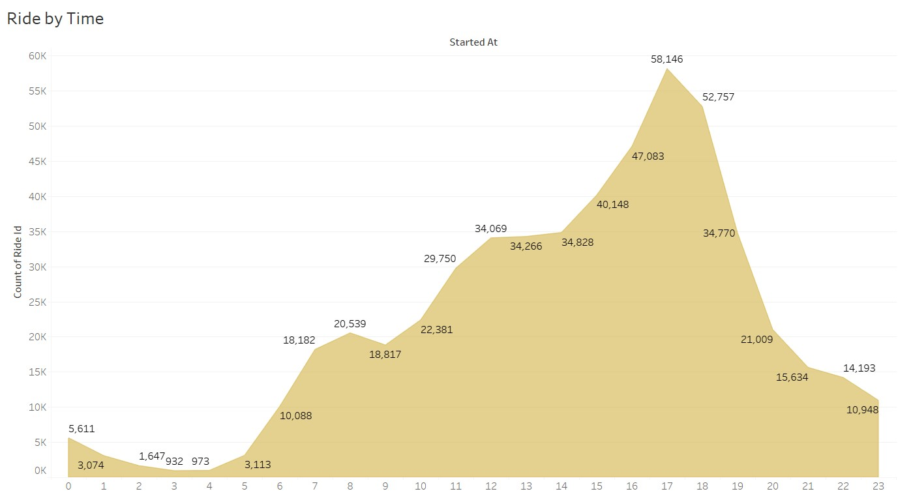
Ride by Time
This area charts visualization shows the ride done by each hour.
Most number of people loves to ride between 17th and 18th hour of a day.
This chart says Afternoon to Evening time is the best time to ride.

Slide 7
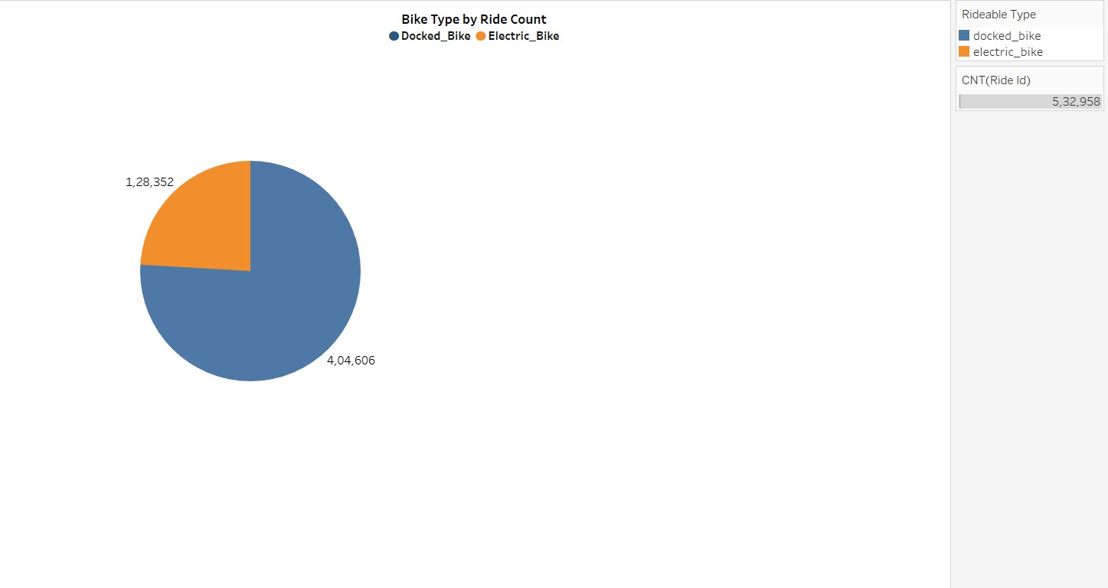
Bike Type
This pie chart visualization shows the bike types people used.
There are two different types of bikes which are Docked Bike & Electric Bike.
Most of the people concentrates on Docked Bikes where the Electric bikes are still evolving.

Slide 8
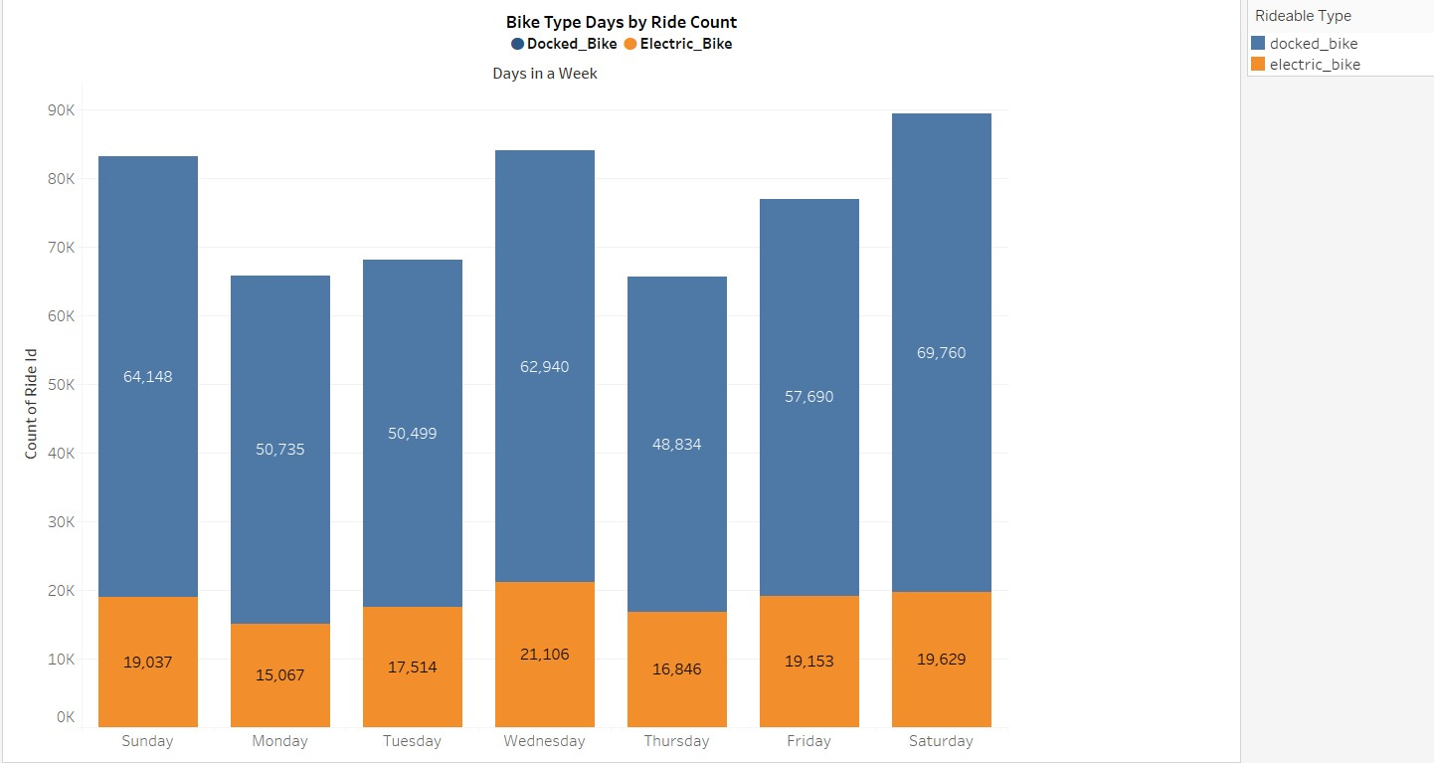
Bike Type Days
This horizontal bars visualization shows the bike types people used in each days.
Saturday has the most number of riders with Docked Bike.
People with Electric Bike rides most on Wednesday.

Slide 9
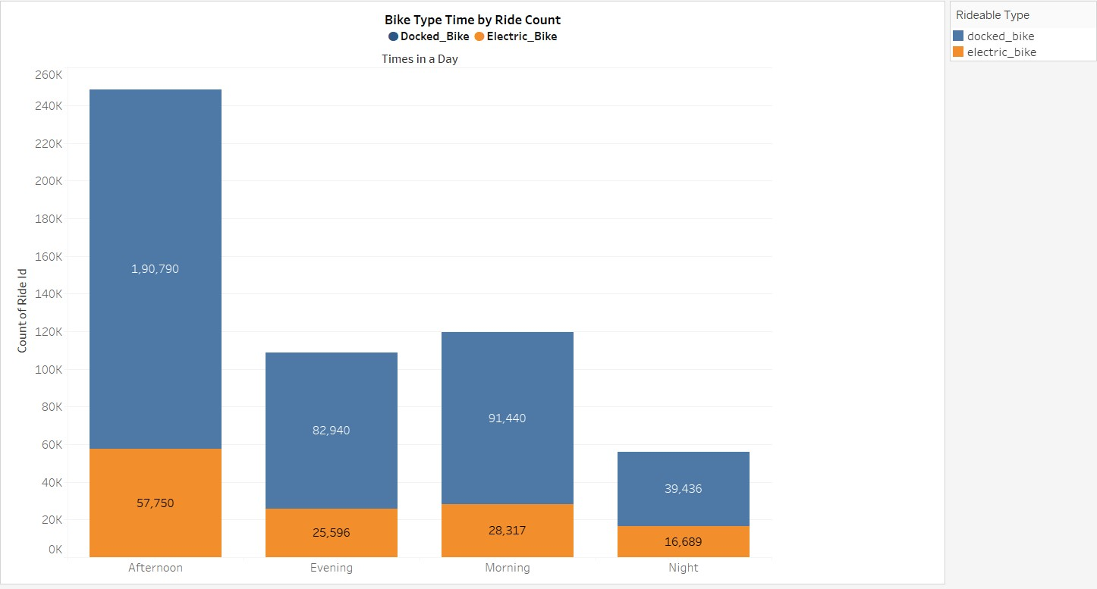
Bike Type Time
This horizontal bars visualization shows the bike types people used by the time.
Afternoon has the majority riders of Docked Bike and Electric Bike as well.
Least people prefers to ride in the night with both the bike segments.

Slide 10
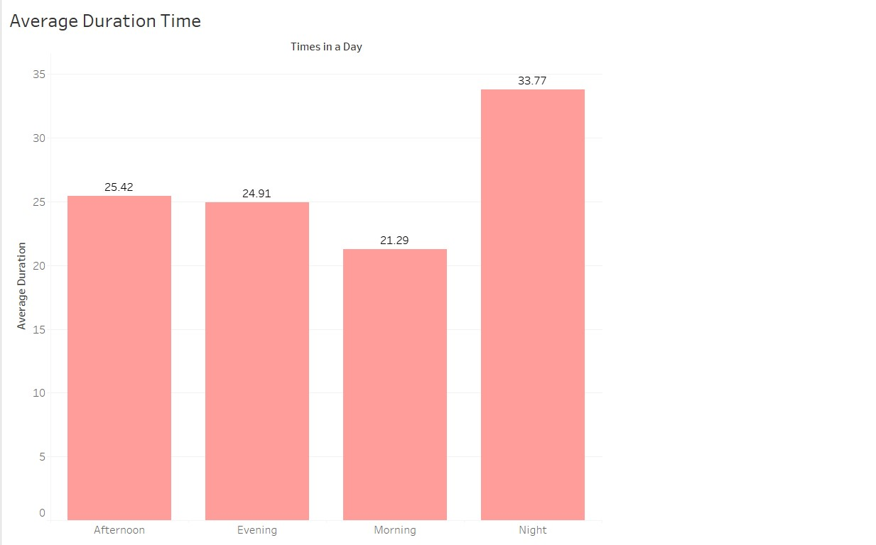
Average Duration Time
This horizontal bars visualization shows the average duration time in a day.
In an average calculation, Night has the most number duration .
There are least differences in the average view still Morning has the lowest duration.

Slide 11
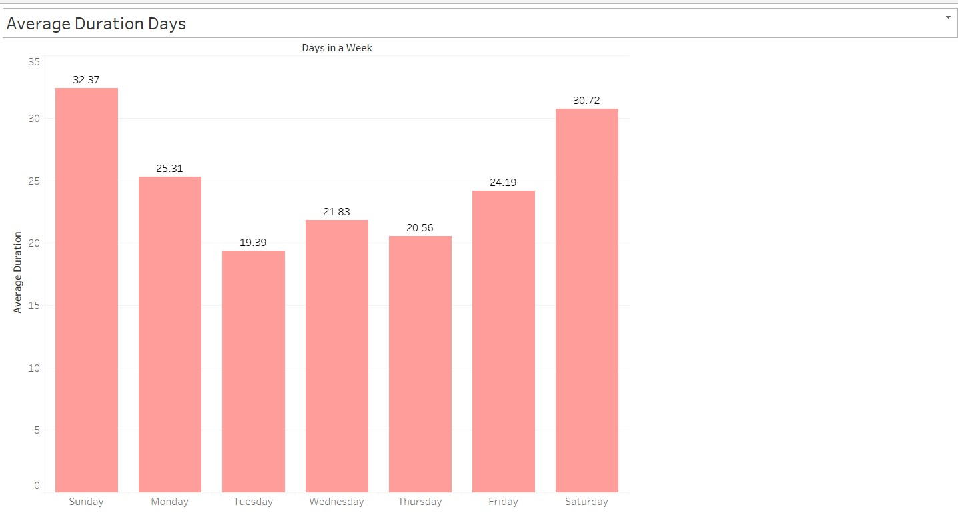
Average Duration Days
This horizontal bars visualization shows the average duration days in a week.
Weekend has the highest average comparing to the weekdays.
However, Sunday leads than Saturday in the weekends.

Slide 12
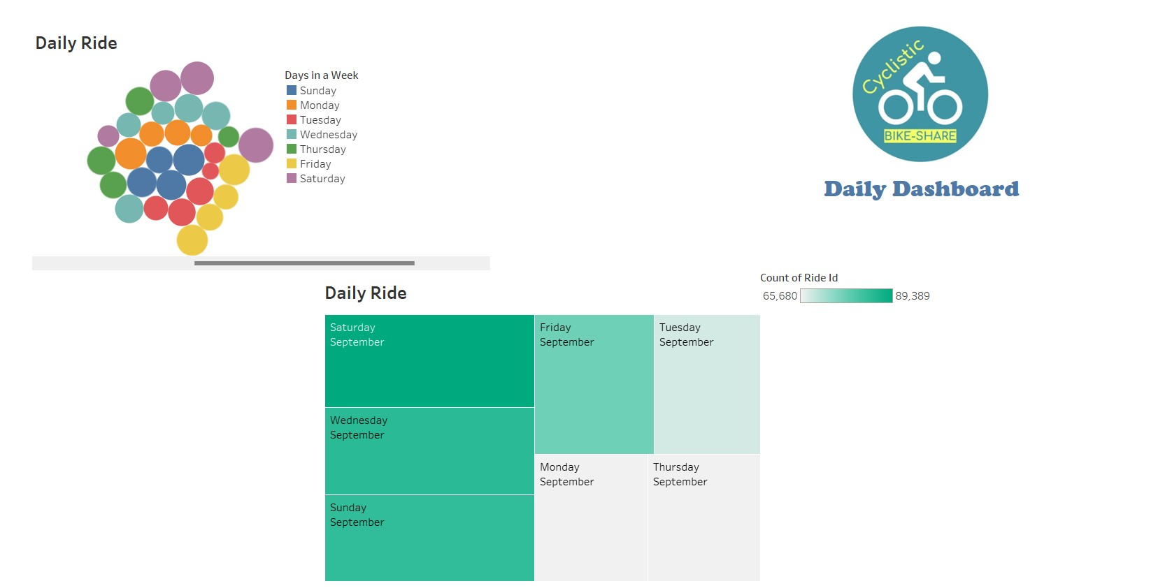
Daily Ride Dashboard

Slide 13
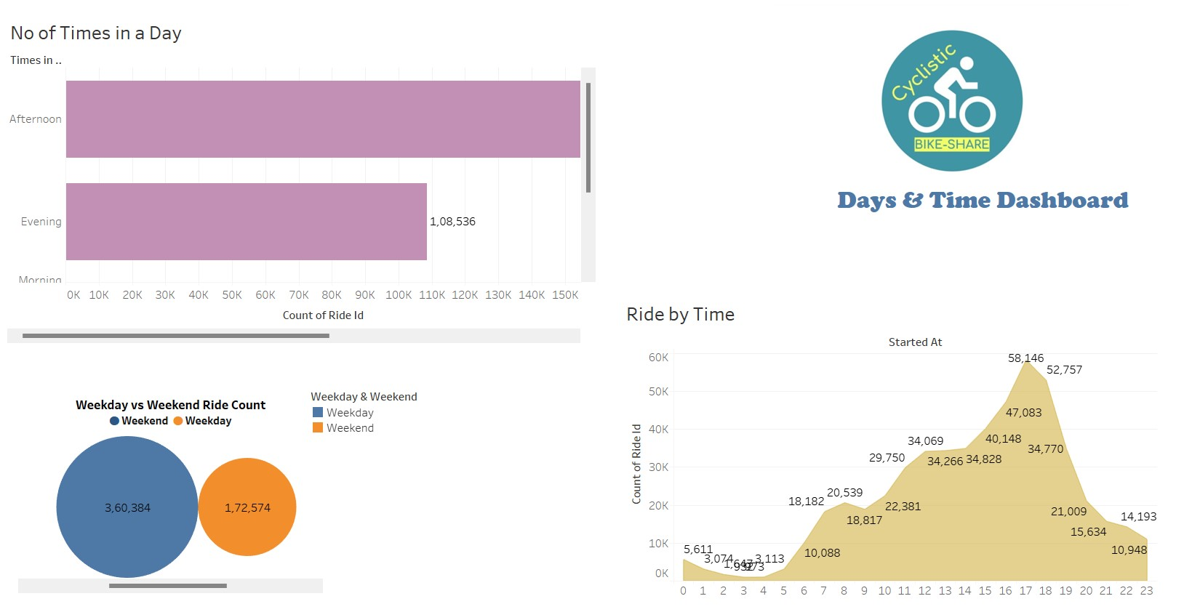
Date & Time Dashboard

Slide 14
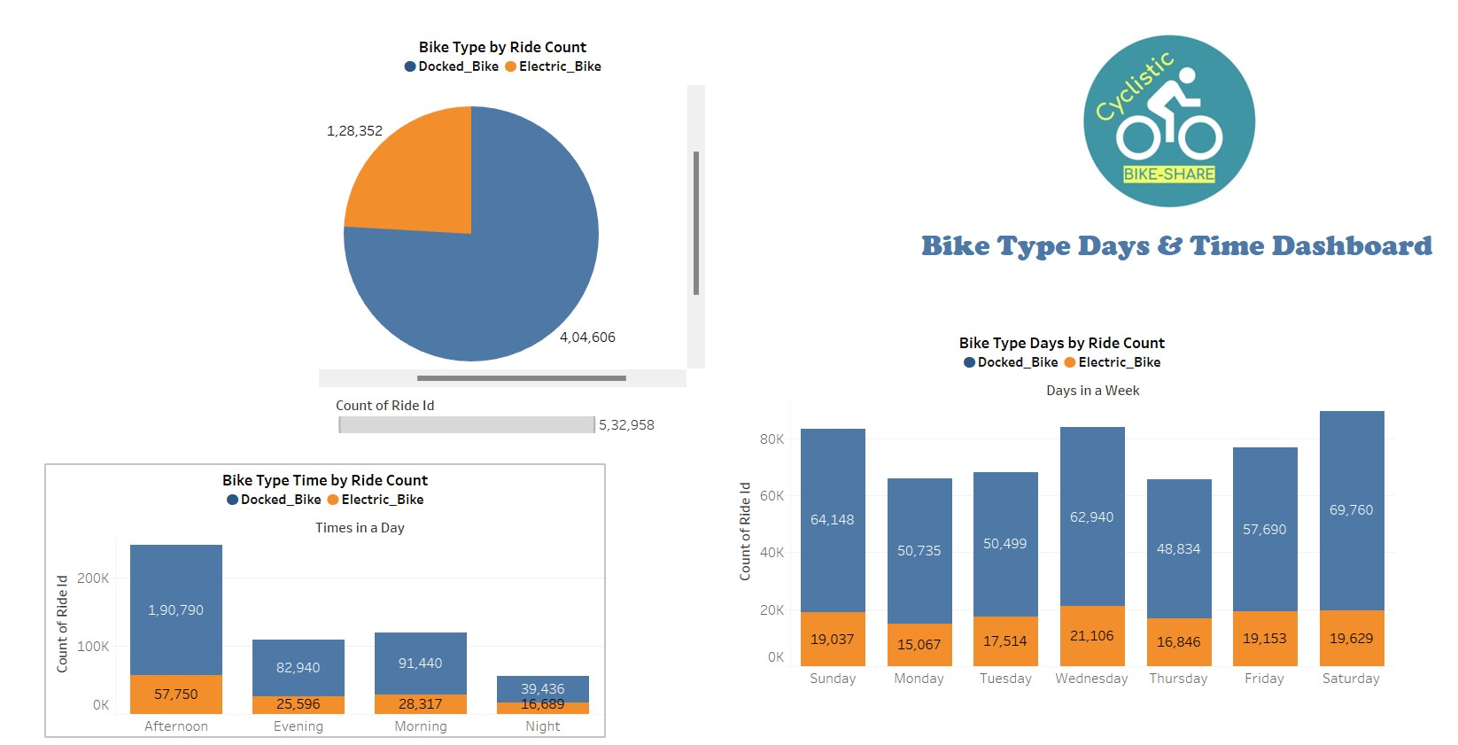
Bike Type Days & Time Dashboard

Slide 15
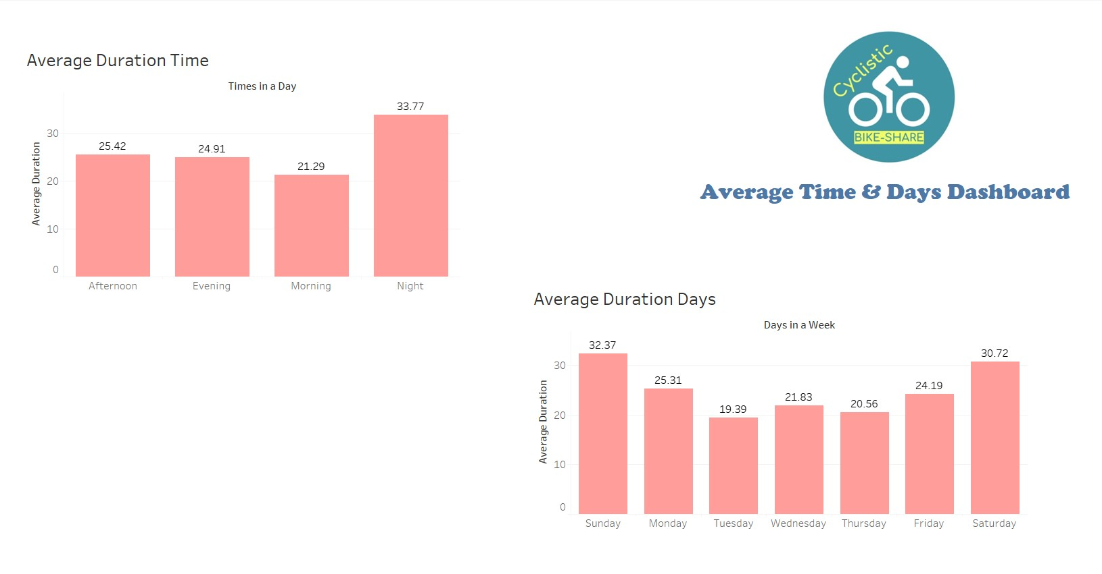
Average Time & Days Dashboard

Slide 16
Overall the project says,
Totally we have 5,32,958 rides completed
Average ride duration is 25.27
And Weekends has the most numbers of rides people has done
People prefer more to go riding on the Afternoon

Slide 17
THANK YOU
K G GOKUL
MBM6

